Slide 1
Tracing
Complexity Theory
ESD.83 – Research Seminar in Engineering Systems
P. Ferreira
October 2001

Slide 2
Outline
Views
Definition
Approach
Applications
Early History
People
Institutions
Research
Assessment
References

Slide 3
Views
Study of complicated systems:
  A system is complex when it is composed of many parts that interconnect in intricate ways. (Joel Moses, “Complexity and Flexibility”). This definition has to do with the number and nature of the interconnections. Metric for intricateness is amount of information contained in the system
  A system presents dynamic complexity when cause and effect are subtle, over time. (Peter Senge, “The Fifth Discipline”). Egs: dramatically different effects in, the short-run and the long-run; dramatically different effects locally and in other parts of the system; obvious interventions produce non-obvious consequences
  A system is complex when it is composed of a group of related units (subsystems), for which the degree and nature of the relationships is imperfectly known. (Joseph Sussman, “The New Transportation Faculty”). The overall emergent behavior is difficult to predict, even when subsystem behavior is readily predictable. Small changes in inputs or parameters may produce large changes in behavior

Slide 4
Views
Study of complicated systems:
  A complex system has a set of different elements so connected or related as to perform a unique function not performable by the elements alone. (Rechtin and Maier, “The Art of System Architecting”). Require different problem-solving techniques at different levels of abstraction
  Scientific complexity relates to the behavior of macroscopic collections of units endowed with the potential to evolve in time. (Coveney and Highfield, “Frontiers of Complexity”). This is different from mathematical complexity (number of mathematical operations needed to solve a problem, used in computer science)
  Complexity theory and chaos theory both attempt to reconcile the unpredictability of non-linear dynamic systems with a sense of underlying order and structure. (David Levy, “Applications and Limitations of Complexity Theory in Organizational Theory and Strategy”). Implications: pattern of short-term predictability but long-term planning impossible, dramatic change unexpectedly, organizations can be tuned to be more innovative and adaptive

Slide 5
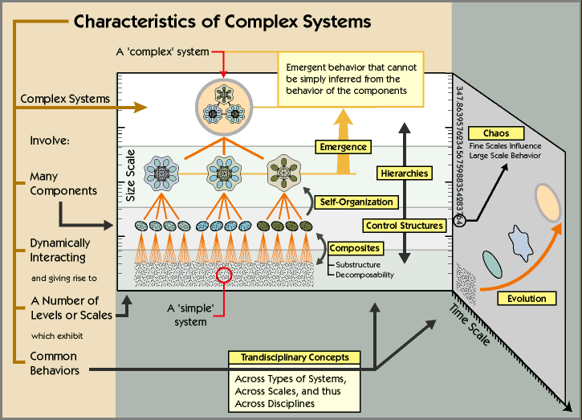
Views

Slide 6
Definition
The Newtonian Paradigm is built on Cartesian Reductionism:
  Machine Metaphor and Cartesian Dualism (Descartes): Body is a biological machine; mind as something apart from the body; Intuitive concept of machine: built up from distinct parts and can be reduced to those parts without losing its machine-like character: Cartesian Reductionism
  The Newtonian Paradigm and the three laws of motion: General Laws of motion, used as the foundation of the modern scientific method. Dynamics is the center of the framework, which leads to trajectory
Complexity results from failure of the Newtonian Paradigm to be generic:
  Complex and simple systems are disjoint categories that encompass all of nature
  But the real world is made up of complex things and the world of simple mechanisms is fictitious and created by science. Experiments involve reducing the system to its parts and then studying those parts in a context formulated according to dynamics
How is science done?
  Senses (observe the world) + Mental activity (make sense out of that sensory information). Encode natural system (NS) into formal system (FS); manipulate FS to mimic the causal change in the NS. From the FS derive an implication that corresponds to the causal event in the FS; decode the FS and check its success in representing the causal event in the NS

Slide 7
Definition
Definition of Complexity:
  “…The world, from which we single out some smaller part, the NS, is converted into a FS that our mind can manipulate and we have a model. The world is complex. The FS we chose to try to capture it can only be partially successful. For years we were satisfied with the Newtonian Paradigm as the FS, forgot about there even being and encoding and decoding, and gradually began to change the ontology so that the Newtonian Paradigm actually replaced or became the real world. As we began to look more deeply into the world we came up with aspects that the Newtonian Paradigm failed to capture. Then we needed an explanation. Complexity was born! This easily can be formalized. It has very profound meaning…”
  “…Complexity is the property of a real world system that is manifest in the inability of any one formalism being adequate to capture all its properties. It requires that we find distinctly different ways of interacting with systems. Distinctly different in the sense that when we make successful models, the formal systems needed to describe each distinct aspect are NOT derivable from each other…”
Bob Rosen and Don Mikulecky, Professors of Physiology
Medical College of Virginia Commonwealth University

Slide 8
Definition
Implications of this definition:
  A complex system is non-fragmentable. If it were it would be a machine. Their reduction to parts destroys important system characteristics irreversibly
  A complex system comprises real components that are distinct from its parts.There are functional components defined by the system which definition depend on the context of the system. Outside the system they have no meaning. If removed from the system it looses its original identity
  Complex systems have models, analytic or synthetic. But the tools differ. If a synthetic model can replace an analytic models, the system is fragmentable
  No “largest model”. If there were a largest model, all other models could be derived from it and fragmentability would result
  Causalities in the system are mixed when distributed over the parts. The nature of causality requires closed loops of excluded in the Newtonian Paradigm
The important attributes of the system are beyond algorithmic definition or realization: a path to refute Church's thesis (“…All the models of computation yet developed, and all those that may be developed in the future, are equivalent in power. We will not ever find a more powerful model...”)

Slide 9
Definition
Ideas related to Complexity:
  Size: Egs “the size of a genome“; “the number of species in an ecology”. Size is indication of difficulty in dealing with the system. But for complexity, such parts need to be inter-related
  Ignorance: Eg”the brain is too complex for us to understand“.Complexity is the cause of ignorance. Cannot completely associate the two (other significant causes?)
  Minimum Description Length: Kolmogorov Complexity is the minimum possible length of a description in some language (usually that of a Turing machine)
  Variety: Eg “this species markings are complex due to their great variety”. Variety is necessary for complexity but it is not sufficient for it
  (Dis)Order: Complexity is mid-point between order and disorder
Complexity
Disorder

Slide 10
Definition
“…Complexity is that property of a language expression which makes it difficult to formulate its overall behavior, even when given almost complete information about its atomic components and their inter-relations…"
Bruce Edmonds, Senior Research Fellow in Logic and Formal Methods
Center for Policy Modeling, Manchester Metropolitan University, UK
Relationship to more specific definitions of complexity:
  Computational Complexity: amount of computational resources needed to solve a class of problems. Lacks the difficulty of providing the program itself
  Bennett's Logical Depth: computational resources to calculate the results of a program of minimal length
  Löfgren's Interpretation and Descriptive Complexity: the combined processes of interpretation and description. Eg: interpretation: decoding of the DNA into the effective proteins; description: process the result of reproduction and selection on the information there encoded
  Kauffman's number of conflicting constraints: complexity is the number of conflicting constraints. This represents the difficulty of specifying a successful evolutionary walk given the constraints

Slide 11
Approach
Abstraction, Modularity and Scales
Eg from Physics: Matter
{-∑_{i}(ϑ²∇²_{i})/(2m_{e})-∑_{i}(ϑ²∇²_{j})/(2m_{n})+e²/(4πε₀)∑_{i1,i2}1/|r_{i1}-r_{i2}|+
+z²e² /(4πε₀) ∑_{j1,j2}1/|R_{j1}-R_{j2}|-ze² /(4πε₀) ∑_{i,j}1/|r_{i}-R_{j}|}ψ=Eψ
But cannot solve analytically even if i=2 and j=1 (Helium)
What to do? Characterize the behavior of the system at a different scales
  Eg: molecules (mass, charge, poles, symmetries,…)
Or use Computer Simulation (major tool)

Slide 12
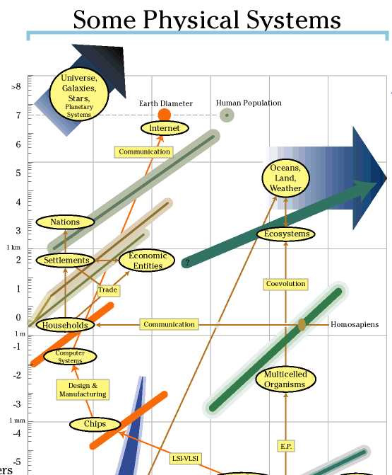
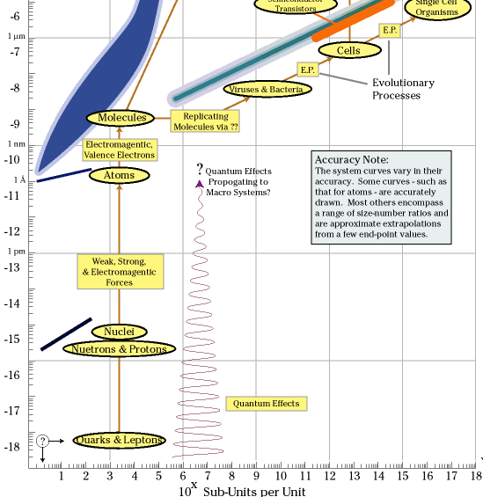
Approach

Slide 13
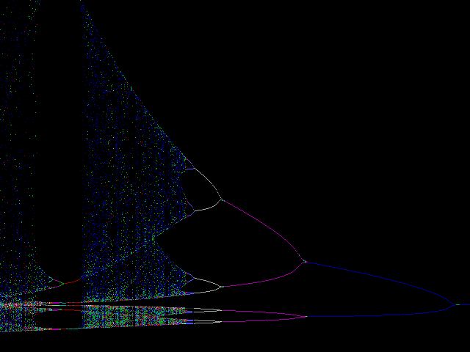
Approach
But computers have limited expressive power. Computers with 32 bits have steps of at least 2.328⁻¹⁰. For some systems, a difference of this magnitude in the input conditions lead to very different outcomes
Eg: M. Feigenbaum studies of population growth models
Population_{t} = GrowthRate*Population_{t-1}(1-Population_{t-1})
Feigenbaum Constant: 4.6692016…
Growth Rate

Slide 14




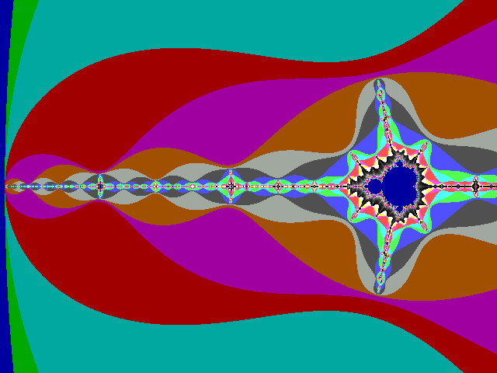
Approach
But the Feigenbaum constant appears in many other contexts
Eg: the Mandelbrot Set
  Equation: Z(n+1)=Z(n)²+C, C and Z imaginary numbers
  Mapping: represents the number of iterations need for |Z(n)|>2
The importance of the Feigenbaum constant:
It is an invariant

Slide 15
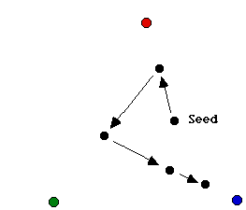
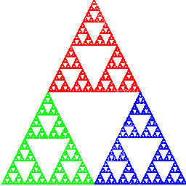
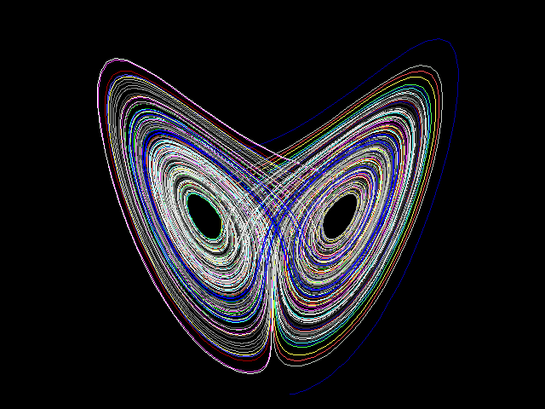
Approach
Dissipation of the initial conditions:
  Eg: The Sierpinski Triangle
Idea of Attractor:
  Eg: Lorentz Attractor (dx/dt=-a*x+a*y;dy/dt=b*x-y-z*x;dz/dt=-c*z+x*y; dt =.02, a=5, b=15, c=1)
The importance attractors:
Reduce the space state

Slide 16

Approach
Cellular automata: array of finite state machines (inter-related)
  Lattice of sites, each lattice can take one of k values
  Levels of lattices implement different scales of the system
  Discrete in time, each site updates asynchronously depending on neighbors
  Every site updates according to a local pre-defined rule
  Fixed point and limiting cycles become common

Slide 17
Applications
Complexity Theory appears in many fields:
  The more traditional ones: physics, biology, computer science
Other examples include
  Transportation Systems
  (Joseph Sussman, Professor Civil and Environmental Engineering, MIT)
    Transport systems are complex networks, internally interconnected at different scales
    The system is stochastic by nature and policy-makers introduce strategies that affect the overall behavior of the system
  Dynamic Markets and Firms
  (Chris Meyer, E&Y Partner and Director of the Center for Business Innovation)
    The market is ever changing, defined by firm interaction
    Inside the firm: make boundaries permeable, allow the bottom-up flow of ideas, give up of the idea of equilibrium

Slide 18
Early History
Complexity is related to the NP-completeness of some problems (combinatorial explosion). First known problem of this sort is:
  “Given n points and the distance between every pair of them, find the shortest route which visits each every point at least once and then returns to the starting point”
There was a German book published in 1832 about this problem
The problem entered the mathematical world only one century later by Merrill Flood, who urged the RAND computer company to offer a prize for its solution. Merrill Flood, together with Melvin Dresler, were the first to work out formally the Prisoner’s Dilemma in 1950. They were involved in researching strategies for nuclear war
Dantzig, Fulkerson and Johnson (Computer Science Department at Stanford University) published a paper, in 1954, published a paper showing that a solution is optimal by looking at some inequalities (49-city map of the 48-state United States, needs 25 inequalities)
  G. B. Dantzig, R. Fulkerson, and S. M. Johnson, "Solution of a large-scale traveling salesman problem", Operations Research 2 (1954), 393-410
Researchers understood that problems fall into two-categories: the good and the bad ones. Once you solve one problem, you actually solve a class of similar problems

Slide 19
People
People related to the field come from primarily from mathematics, physics, computer science and biology
Among the most prominent people we find:
  Stuart Kauffman - Pioneer in complexity theory; MD from University of California (1968), Professor in Biophysics, Theoretical Biology and Biochemistry (1969-1995), University of Chicago and University of Pennsylvania; Currently, consultant for Los Alamos National Laboratory and External Professor, Santa Fe Institute; Publication: “At Home In The Universe”, Oxford University Press, 1995
  Murray Gell-Mann – Theoretical physicist; PhD (Physics) 01/51, MIT; Professor Emeritus of Theoretical Physics,California Institute of Technology; Professor and Co-Chairman of the Science Board of the Santa Fe Institute; Nobel Prize in 1969, work on the theory of elementary particles (co-discoverer of Quarks); Currently in the President's Committee of Advisors on Science and Technology; Author of the book: “The Quark and the Jaguar”, W. H. Freeman and Company, New York, 1994
  John Holland
  Anderson
  Goedel
  Kolgomorov
  Wolfram
  Selt Lloyd

Slide 20
People
  Philip Anderson – Condensed matter theorist; PhD Harvard (49); Professor of Physics at Oxford University and Princeton University (75-present); Nobel Prize in 1975 for investigations on the electronic structure of magnetic and disordered systems; Also at the Bell Labs (49-84) and Santa Fe Institute (70-present)
  John Holland – “first” PhD in Computer Science (University of Michigan); pioneer of evolutionary computation, particularly genetic algorithms; Professor of Cognition and Perception at the University of Michigan and Santa Fe Institute
  Others: Selt Llyod (Physics), Joseph Sussman (Civil), Christopher Langton (Computer Science), Brian Arthur (economics), Jack Cowan (maths), Herbert Simon (economics), John Smith (biology), Per Bak (physics)

Slide 21

Institutions
Santa Fe Institute
  Private, non-profit, multidisciplinary research and education center, founded in 1984
  Largely Supported by the NSF and MacArthur Foundation
  Operates as a small visiting institution
  Catalyzes new collaborative, multidisciplinary projects
  Primarily devoted to Basic Research
  Gathers about 100 members, 35 in residence at one time

Slide 22
Research
  Areas of research (at SFI) include:
    Computation in Physical and Biological Systems
    Economic and Social Interactions
    Evolutionary Dynamics
    Network Dynamics;
  Can science achieve a unified theory of complex systems?
    “From Complexity to Perplexity”, by J. Horgan, Scientific American:
    Some (at SFI) argue that it might be possible to have “a new, unified way of thinking about nature, human social behavior, life and the universe itself”
    Some (also at SFI!) argue “we don’t even know what that means”
    Some researchers believe that one day computer power will be enough to predict, control and understand nature
    R. Shepard (Stanford University): “even if we can capture nature's intricacies on computers, those models might themselves be so intricate that they elude human understanding”

Slide 23
Assessment
Complexity theory targets at the heart of systems:
  Understanding the relationship between emergent behavior and intricateness of parts (through the non-fragmentable property)
  Paradigm to think about systems and scales
Spreads to many areas (but by definition)
  Physics, biology, computer science, economics, …
Successful: understanding concept of identity of a system
But there is a challenge: complex systems engineering:
  Design Purposeful Complex Systems
  So far, we have good tools to characterize but not to design
    (eg. Attractors and Pattern recognition)
  Why bother? Is there another way to account for emergent behavior?

Slide 24


References
Complex Systems:
  Founded by Stephen Wolfram in 1987
  Contributors from academia, industry, government
  General public in 40 countries around the world
  Topics: mathematics, physics, computer science, biology
Advances in Complex Systems:
  Founded in 1998
  Editor-in-Chief: Peter F. Stadler, Dept. of Theoretical Chemistry and Molecular Structural Biology, U. Vienna
  Co-Editor-in-Chief: Eric Bonabeau, Santa Fe Institute
  Fields: biology, physics, engineering, economics, cognitive science and social sciences

